Slide 1
Working with Data in an Angular Application
Deborah Kurata
@deborahkurata http://blogs.msmvps.com/deborahk deborahk@insteptech.com
Notes:
"The data required for a client-side Web application is often provided by a back-end Web service. So an Angular application must communicate with that Web service to retrieve and update data. The primary objectives of this session are to: • Understand how a client-side Web Application retrieves data • Evaluate the Existing Angular services for calling a Web Service ($http and $resource) • Build a Common Module and custom Angular Service as a reusable data access component • Fake it and retrieve data without the Web Service"

Slide 2
Deborah Kurata
Independent Consultant | Developer | Mentor
Web (Angular), .NET
Pluralsight Author
AngularJS Line of Business Applications
Angular Front to Back with Web API
Object-Oriented Programming Fundamentals in C#
Microsoft MVP

Slide 3
Session Materials & Sample Code
https://github.com/DeborahK/ab2015

Slide 4
Rate Yourself on Data Access
New to Angular - no proficiency
Just starting out - limited proficiency
Doing it but not fully understanding it - working proficiency
Been there, done that, can help others - full proficiency

Slide 5

Overview
Request/Response flow
Angular services for accessing data
Building a reusable data access service
Faking data access
OData queries

Slide 6
JavaScript Promise
Launch an asynchronous operation
Up to 3 Callback Functions
Async Operation
Return immediately
As the operation progresses …
When the operation is complete
If the operation is successful …
If the operation fails …
Notes:
Before we get started … I want to ensure we are all on the same page regarding JavaScript promises.

Slide 7
Demo: Angular in Action
Notes:
2) Movie Hunter
This is the code we will look at in this session

Slide 8



Web Server
Web Browser
URL Request (www.mysite.com)
HTML
HTML
Response (Page and Assets)
Java-Script
Java-Script
HTTP Service
DB

Slide 9
Web Server
Web Browser
HTML
URL Request (www.mysite.com)
HTML
Response (Page and Assets)
Java-Script
Java-Script
(http://mysite/api/movies)
HTTP Service
Response
DB
Data

Slide 10
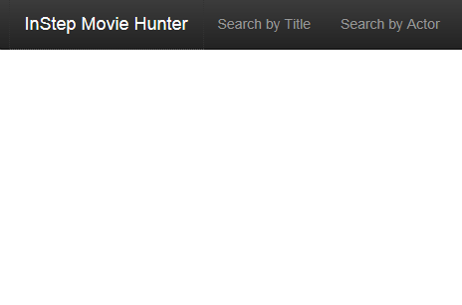
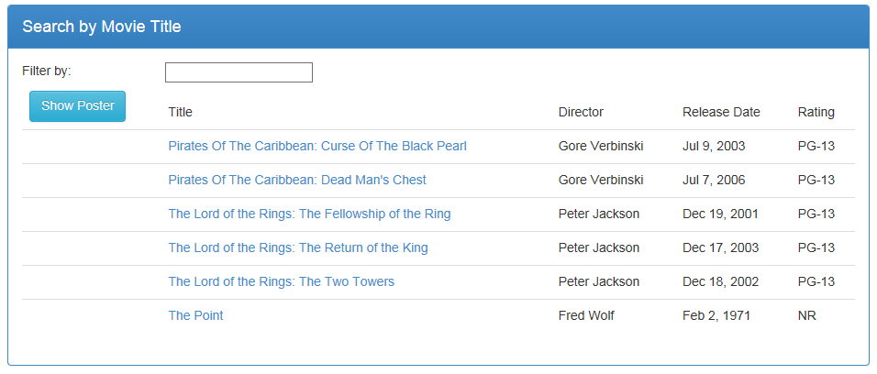
Retrieving Data
HTTP Service
GET Request
api/movies
Notes:
Let's look at this same process from a different perspective.
Request is asynchronous, so the user could select a different option or close the browser.

Slide 11
Retrieving Data
HTTP Service
GET Request
api/movies
Response
[
{ director: "Peter Jackson",
movieId: 1,
mpaa: "pg-13",
releaseDate: "2001-12-19T00:00:00",
title: "The Lord of the Rings: The Fellowship of the Ring"
},
{ director: "Peter Jackson",
movieId: 2,
mpaa: "pg-13",
releaseDate: "2002-12-18T00:00:00",
title: "The Lord of the Rings: The Two Towers"
},
...
]

Slide 12
Angular Services for Accessing Data
$http
$resource
$httpBackend

Slide 13
$http
$http.get("/api/movies/")
.then(function(response) {
vm.movies = response.data;
});
Built into Angular Core
Facilitates communication with a back-end service (get, post, put, delete, …)
Asynchronous
Notes:
When the request is complete:
The callback function is executed
The response object is passed in

Slide 14
REST
REpresentational State Transfer
Requests and responses involve the transfer of resources
Resources are identified with a URL
/api/movies/
Requests utilize a standard set of HTTP verbs
GET | POST | PUT | DELETE
And much more!

Slide 15
$resource
function movieResource($resource) {
return $resource("/api/movies/:movieId")
}
Separate Angular component: angular-resource (ngResource)
Abstraction on top of $http for calling RESTful services
Requires less code
Notes:
One function for all operations: Get, Put, Post

Slide 16
Reusable Data Access Service
Angular module
(common.services)
Angular module
(movieHunter)
Custom Angular service
(movieResource)
HTTP Service
View
(movieList View)
Angular controller
(movieListCtrl)
Built in $resource service
Model
Methods
Notes:
Let's zoom in on the movieResource service

Slide 17
Built-In $resource Methods
Angular module (common.services)
movieResource service
$resource service
Query
Get
Save
HTTP Service
GET Request
api/movies
GET Request
api/movies/5
POST Request
api/movies
Notes:
Query -> Array
Get -> Single item

Slide 18
$resource Methods
Method Name | Verb | URL | Description
query | GET | /api/movies | Retrieves all of the movies
get | GET | /api/movies/5 | Retrieves the specified movie
save | POST | /api/movies | Saves modifications to the movie
movieResource.query(function (data) {
vm.movies = data;
});
movieResource.get({ movieId: $routeParams.movieId },
function (data) {
vm.movie = data;
});
Notes:
Notice that both of these methods are called using the service "class".

Slide 19
$resource Methods (cont)
Method Name | Verb | URL | Description
query | GET | /api/movies | Retrieves all of the movies
get | GET | /api/movies/5 | Retrieves the specified movie
save | POST | /api/movies | Saves modifications to the movie
vm.movie.$save(function (data) {
vm.message = "Save successful.";
});
Notes:
This method is called using the instance.

Slide 20
Post vs. Put
POST (api/movies)
PUT (api/movies/5)
Posts data for a resource or set of resources
Used to:
Create a new resource when the server assigns the Id
Update a set of resources
Not idempotent
Puts data for a specific resource with an Id
Used to:
Create a new resource when the client assigns the Id
Update the resource with the Id
Idempotent
Notes:
Idempotent: Multiple calls have no further affect

Slide 21
Creating a Custom $resource Method
function movieResource($resource) {
return $resource("/api/movies/:movieId", null,
{
'update':{method:'PUT'}
});

Slide 22
$resource Methods
Angular module (common.services)
movieResource service
$resource service
Query
Get
Save
Update
GET Request
HTTP Service
api/movies
GET Request
api/movies/5
POST Request
api/movies
PUT Request
api/movies/5

Slide 23
Demo: Retrieving Data
Notes:
Create a new module (common.services.js)
Add a script tag for the .js file (index.html)
Define the new module as a dependency (app.js)
Add a custom Angular service (movieResource)
Add a script tag for the .js file (index.html)
Inject the service into the controller
Call the $resource methods

Slide 24
$httpBackend
Angular’s fake HTTP backend implementation
Mocks the calls to the Web Service
Returns static data to the application
Two implementations:
ngMock: for unit testing applications
ngMockE2E: for end-to-end testing or backend-less development

Slide 25
Steps to Mocking the Web Server
Create a new module that depends on ngMockE2E
Add the new module as a dependency in the Main Module
Define the fake responses to the Web Service calls
Set up static data
Notes:
ngMockE2E is contained in angular-mocks.js that is downloaded with angular core.

Slide 26
Demo: Faking Data Retrieval
Notes:
Create a new module
Add a script tag for the .js file (index.html)
Define the new module as a dependency (app.js)
Set up the static data
Define the fake responses

Slide 27
OData
Open Data Protocol
Standard way to access data using HTTP
Protocol largely follows REST conventions
And there is a large spec

Slide 28
OData Queries
Allow construction of complex data queries
Filter, shape, sort, and select data
Examples:
$filter: "contains(Title,'Rings')"
$filter: "contains(Title,'Rings') and StarRating gt 4.5"
$filter: "contains(Title,'Rings') and StarRating ge 4.8 and StarRating le 5", $orderby: "StarRating desc"
Notes:
Added as part of the URL as a query string.

Slide 29
OData Query Options
Option | Description | Example
$top | Returns the top n results | $top: 3
$skip | Skips n results | $skip: 1
$orderby | Sorts the results | $orderby: "StarRating desc"
$filter | Filters the results based on an expression | $filter: "StarRating gt 4.5"
$select | Selects the properties to include in the response | $select: "Title, MovieId"
http://www.odata.org/ Developers -> Documentation

Slide 30
Demo: OData Queries
Notes:
Run app first with no queries and with F12 tools.
Then add $Skip: 1, $Top: 3 with F12 tools.

Slide 31
Take Away
Building a reusable data access service
Faking data access
OData queries

Slide 32
Thank You!
@deborahkurata
deborahk@insteptech.com
http://blogs.msmvps.com/deborahk
https://github.com/DeborahK/ab2015

